Slide 1
SUDAN
By: ABDULLAH

Slide 2
A brief introduction
Sudan comes from the Arabic phrase bilād al-Sūdān, "land of the blacks.“ 😳
Is a country in Northeast Africa
Has a population of 44.91 million people as of 2021

Slide 3
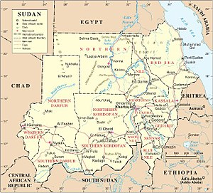
Geography
Sudan is situated in northern Africa, with an 853 km (530 mi) coastline bordering the Red Sea.^{[155]} It has land borders with Egypt, Eritrea, Ethiopia, South Sudan, the Central African Republic, Chad, and Libya. With an area of 1,886,068 km² (728,215 sq mi), it is the third-largest country on the continent (after Algeria and Democratic Republic of the Congo) and the fifteenth-largest in the world.

Slide 4
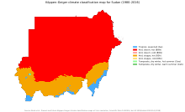
Climate
The amount of rainfall increases towards the south. The central and the northern part have extremely dry, desert areas such as the Nubian Desert to the northeast and the Bayuda Desert to the east; in the south, there are grasslands and tropical savanna. Sudan's rainy season lasts for about four months (June to September) in the north, and up to six months (May to October) in the south.

Slide 5
Environmental Issue
Desertification is a serious problem in Sudan.^{[159]} There is also concern over soil erosion. Agricultural expansion, both public and private, has proceeded without conservation measures. The consequences have manifested themselves in the form of deforestation, soil desiccation, and the lowering of soil fertility and the water table.^{[160]}

Slide 6
Sudanese Food
Gorassa
Baseema
Shaaria

Slide 7


